Slide 1
Music Information Search Utility
Instantly search for artists, albums, songs, and tracks + lyrics
Fisnik [[nerd]]
Jerry [[coder/mathematician]]

Slide 2
What’s this all about?
We’ve built a music information search utility tool.
Why?
We simply felt we wanted to build something cool and still useful.
Notes:
We’ve built a Music Information Search Utility tool, which allows anyone to search and find information about their favorite artist or look up information about an album.
We also store history of what he/she looked at locally. We thought this was an epic idea and set out to explore for the fun sake as well.

Slide 3
Stack Technical Decisions – Part 1
Reactjs was chosen as the core framework of this project due to the simplicity, clean, and single-page nature of this web application.
Why this decision? In almost 2021 ? As we outline in the section “technical decisions” on Github …
Notes:
One of React’s core strengths lies in building web applications with pages that act independently from each other, for example, a component displaying time can do this in its own state without being affected by changes in another component on the same page [1].
The first reason we decided React over Angular, is because we liked how easy it is to quickly get started and code, there is a huge community and React is also a lot more popular compared to Angular [2]. On a technical note [3]: “one of the powerful sides of React is that it provides a good abstraction which means that it does not expose any complex internals to the user.” In addition, since none of us had good previous experience with TypeScript we felt it would require extra time to pick up and fully learn. Furthermore, Angular has a steep learning curve and is not well-documented [4].
When it came to Vue.js, we knew that both Vue.js and Reactjs are two of the biggest and most popular front-end frameworks out there. However, they both as always come with differences. Virtual DOM is something both frameworks implement, which allows you to refresh parts of the page, or single components without reloading the whole page [5]. Component-based development which allows code reuse and improves productivity, and speed is provided by both [5]. Syntax differs a bit. But Reactjs at the time of decision had and still probably has more widespread usage.
The last reason we decided to go with React is because of light previous experience with this framework, we decided to explore it deeper and build something cool.
[1] https://www.simform.com/why-use-react/
[2] https://gist.github.com/tkrotoff/b1caa4c3a185629299ec234d2314e190
[3] https://stories.jotform.com/7-reasons-why-you-should-use-react-ad420c634247
[4] https://technostacks.com/blog/react-vs-angular/
[5] https://www.monterail.com/blog/vue-vs-react-2020

Slide 4
Stack Technical Decisions – Part 2
We decided to make our own components and our own CSS.
Why did we abandon some of the popular CSS Frameworks out there?
Notes:
Bootstrap which is a popular CSS Framework was out of the list quickly, because it’s simply ugly and wouldn’t fit here.
The other candidates were too messy and wouldn’t fit here. We abandoned all these options because: (1) wanted more
control over our user interface and (2) wanted to do something better than what exists out there.
Source: https://geekflare.com/best-css-frameworks/

Slide 5
Stack Technical Decisions – Part 3
We picked the third-party web APIs that would suite what we were building, very straight forward. Used third-party web APIs are listed
here:
Spotify Web API (Core Driver)
Napster Web API
Wikipedia Web API (for additional details about artists e.g., bio summary)
APISEEDS Lyrics API

Slide 6
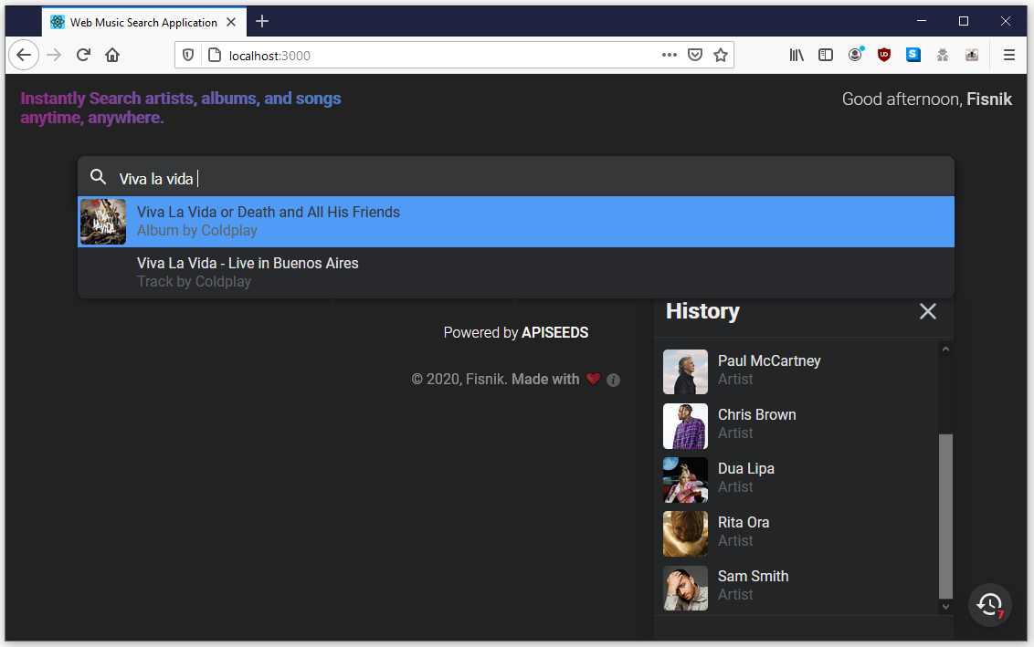
The Music Search Utility

Slide 7
Challenges
We’ve first set out to build a news bookmarking site with a few pages.
But, later due to time constraints and manpower, we quickly decided to abandon that initial idea. It simply wasn’t hype enough!
Web Music Player App [got started, but abandoned]
Music Search Utility, we were hooked and found this cool and re-routed everything, complete pivot!
Notes:
But when we downsized the team and were left two developers. We then quickly realized we needed something different. We then set out to build a music player.
For the music player we wanted to extend the UI of default HTML Audio API by tapping into it and utilizing its full capabilities. This required us to write a completely custom Player.js with an object of Autio() initialized. However, as we progressed, we were hunted by the fact that we were doing multiple other things in parallel with this, which in layman’s terms means we had to split the time some how hence more time constraints and minimal stress.
With more occupation as days passed, Fisnik decided to abandon this initial idea about building a Player.js which he started to write and implemented well. However, with a lot more work and occupation elsewhere, the decision was taken a Saturday to pivot and pivot quickly. After the decision was in place, a few days passed, and we had a completely new design and mission.
Finding good APIs wasn’t a BIG challenge, except for the lyrics API. Nevertheless, it was an interesting experience, and it became a bit experimental with Reactjs.
**Time constraint and good ideas were the two culprits in the process of developing this utility.

Slide 8
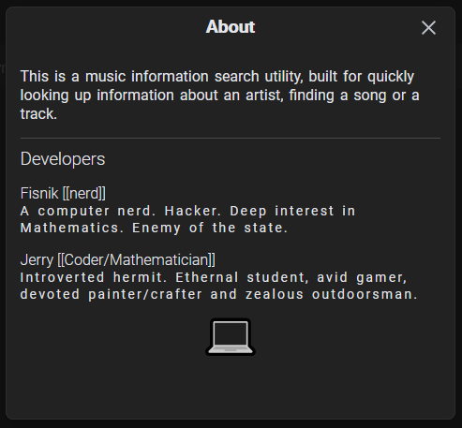
Thank You

